Slide 1
Qlik Sense

Slide 2
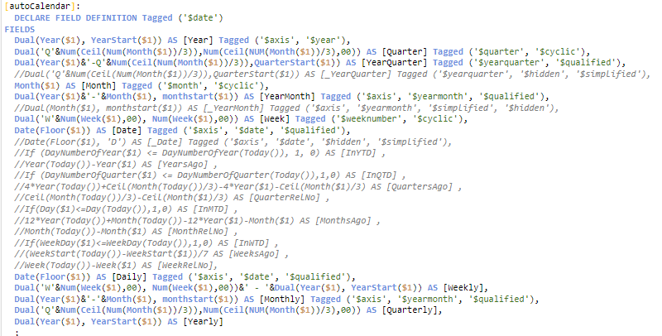
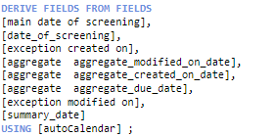
Using table to create function for specific column
Problem: A column need to have multiple changes and will apply to a column but to multiple tables also
Solution: Declare a table to define all the additional transformation to a column and call it later

